Slide 1
Design Patterns in NI LabVIEW
Developer Days 2009

Slide 2
What Is a Design Pattern?
Based on LabVIEW code template or framework
Widely accepted and well-known
Easily recognizable
Notes:
Design patterns are a hot topic amongst LabVIEW developers. There are a number of different design patterns out there, all of which have their merits and potential drawbacks. Design patterns have emerged over the years as the LabVIEW development community has sought to solve a common set of problems. They are essentially templates that make up the foundation of many large LabVIEW applications. The frameworks that are most commonly referred to as design patterns are widely accepted by the LabVIEW development community and are very likely to be recognized by anyone who has familiarized themselves with the pattern before.
So why should you care about design patterns? As many of you are aware, there are a number of potential benefits when using design patterns…

Slide 3
Benefits of Using Design Patterns
Simplify the development process
  Developers can easily understand code
  Do not have to “reinvent the wheel”
  Provide preexisting solutions to common problems
Reliability
  Many have been used for years – they are “tried and true”
  Refer to large development community and resources online
Notes:
LabVIEW is often used to rapidly prototype small applications, but there is an increasing number of large applications being developed using LabVIEW. These applications often encompass large numbers of VIs being developed by groups of developers. Using a design pattern makes it easier for LabVIEW users to read and edit existing code and prevents them having to figure out how to solve classic problems for which the best possible answers already exist.
Also, they’ve been put to the test. They’ve been refined and improved over the years and there are a handful of patterns that have emerged as being exceptionally useful, elegant and powerful. Because these design patterns are such a popular topic of discussion there are a number of online forums with examples, content and thoughts on various patterns (some even ship within LabVIEW)

Slide 4
Getting Started: How Do I Choose?
Identify the most important aspect of your application:
  Processes that require decoupling
  Clean, easy-to-read code
  Mission-critical components
Select a template based on potential to improve
Notes:
When determining which design pattern to use with your application you should already have the architecture of your application in mind and a feel for the various requirements of your application. As you’ll see when we go through these design patterns, they cater to certain scenarios and they aim to solve particular problems. Many of them can address multiple issues that you need help with in your application – it’s also common to see some of the patterns we’ll look at being used in conjunction with one another.
If you’re trying to re-factor an existing application to use a design pattern make sure that the investment required will yield the benefit you seek. When applications reach a point at which they’ve become unruly and difficult to edit or manage they are frequently rebuilt using one of the patterns we’ll look at. However, this is obviously a time-consuming activity, so make sure it’s worth your while and try to take advantage of existing code as much as possible

Slide 5

Caution
You can needlessly complicate your life if you use an unnecessarily complex design pattern.
Do not forget the most common design pattern of all – data flow!
Notes:
Also, after this training when you go back to your LabVIEW application to apply what you’ve learned here, don’t forget these words of caution… basic dataflow is the most important design pattern and a lot of times it’s all you need to get the job done
There’s an entire thread on the NI discussion forums called ‘please don’t do it’ that discusses the ramifications of using an overly complicated design pattern for a fairly simple task. Make sure you select the least common denominator, ie: what is the least complicated method by which you can satisfy all the goals of your application? Remember the famous quote from Joseph Joubert, “A work is perfectly finished only when nothing can be added to it and nothing taken away.”

Slide 6
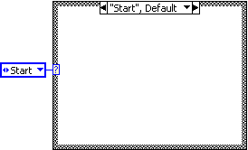
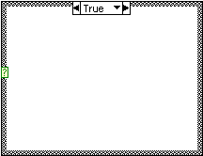
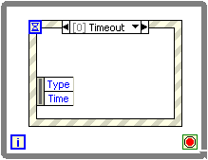
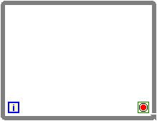
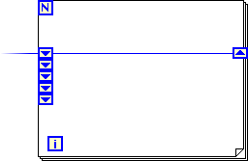
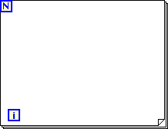
Basic Tools
  Loops
  Shift registers
  Case structures
  Enumerated constants
  Event structures
Notes:
Loops – the two most common loops and the only ones we’ll need for this discussion are the for loop and while loop. The most significant difference is that the while loop iterates indefinitely until stopped, whereas a for loop always has a maximum number of iterations
Shift registers – these are used instead of tunnels if you want to preserve data between iterations of a loop such as a for loop or while loop. On the for loop below I’ve used a set of stacked shift registers, which will remember values from previous iterations
Case Structures – allow you to conditionally execute code depending upon an input, which can be a boolean, string, number, etc… if the input has infinite possibilities, you can set a default case.
Enumerated constants – Allow you to enumerate integer values using words. This is commonly used to govern the case of a case structure instead of just a number. We’ll discuss these more later
Event structures – are similar to case structures, but they interrupt data flow by responding to events that occur. We’ll talk more about this in a moment as well

Slide 7
Today’s Discussion
As we look at each design pattern, we will discuss
  A problem we are trying to solve
  Background
  How it works
  Technical implementation
  Demonstration
  Use cases/considerations
Notes:
All the slides for each design pattern should follow this format. We’ll make a problem statement or describe a scenario we’re trying to address. Before talking about how to implement the solution, we’ll cover any specifics to that particular pattern that you’ll need to be familiar with (code components). Then we’ll discuss implementation and I’ll step you through some demos I’ve prepared. Finally, we’ll discuss when to use each design pattern and some considerations to be aware of.

Slide 8
Design Patterns
Basic
State machine
Event-driven user interface
Producer/consumer
Advanced
Object-oriented programming
Notes:
We’ll start with a couple of simple design patterns and spend most of our time discussing the last three on this slide. We’ll go into low level detail on the last few and we’ll spend some time discussing variations of implementation and any other considerations.

Slide 9

State Machine
National Instruments Customer Education
LabVIEW
Basics I and II
I need to execute a sequence of events, but the order is determined programmatically.
Notes:
The first design pattern that we will consider is the State Machine. State machines permit the program to execute different sections of code (states) in an order that can be determined several different ways.

Slide 10




Background
Static Sequence
Dynamic Sequence: Distinct states can operate in a programmatically determined sequence
Notes:
The diagram at the top is supposed to represent a diagram in which you always know the order of execution. The diagram below is meant to indicate that you will not know the order of execution until run-time. Each subVI has code inside of it that then determines what the next subVI will be.
Allows you to execute code in an order determined at run-time

Slide 11

Vending Machine
Initialize
No Input
Wait
Nickel Deposited
Change Requested
Quarter Deposited
Dime Deposited
Total <50
Quarter
Total <50
Total <50
Change
Nickel
Dime
Total ≥50
Total ≥50
Total ≥50
Total >50
Vend
Exit
Total = 50
Soda costs 50 cents
Notes:
Each state has decision making code inside of it. For example, if you consider the Quarter state, it examines the total amount of money that has been added. If it is equal to or greater than the amount owed, it sends the application to the ‘vend’ state; otherwise, it returns to wait
Walk the audience through an example of execution of this application

Slide 12
Breaking Down the Design Pattern
Case structure inside of a while loop
Each case is a state
Current state has decision-making code that determines next state
Use enumerated constants to pass value of next state to shift registers
Notes:
The standard LabVIEW state machine consists of a large while loop, a shift register to remember the current state, and a case structure that holds separate code to run for each state. (If you use an enum to pass around the value for the current state, the pattern becomes much easier to read – and if you use a typedef, you only need to edit the typedef once in order to add another state to the machine)
Note that each frame in the case structure must contain code for deciding what state the process should go to next. We call this the “transition” code

Slide 13
How It Works
Case structure has a case for every state
Transition code determines next state based on results of step execution
FIRST STATE
Step Execution
Shift registers used to carry state
Transition Code
NEXT STATE
FIRST STATE
Notes:
The state machine pattern is one of the most widely recognized and highly useful design patterns for LabVIEW.
This pattern neatly implements any algorithm explicitly described by a state diagram (flow charts work too…). More precisely, it implements any algorithm described by a “Moore machine” – that is, a state machine which performs a specific action for each state in the diagram. (Contrast this with the “Mealy machine” which performs an action for each transition…)

Slide 14
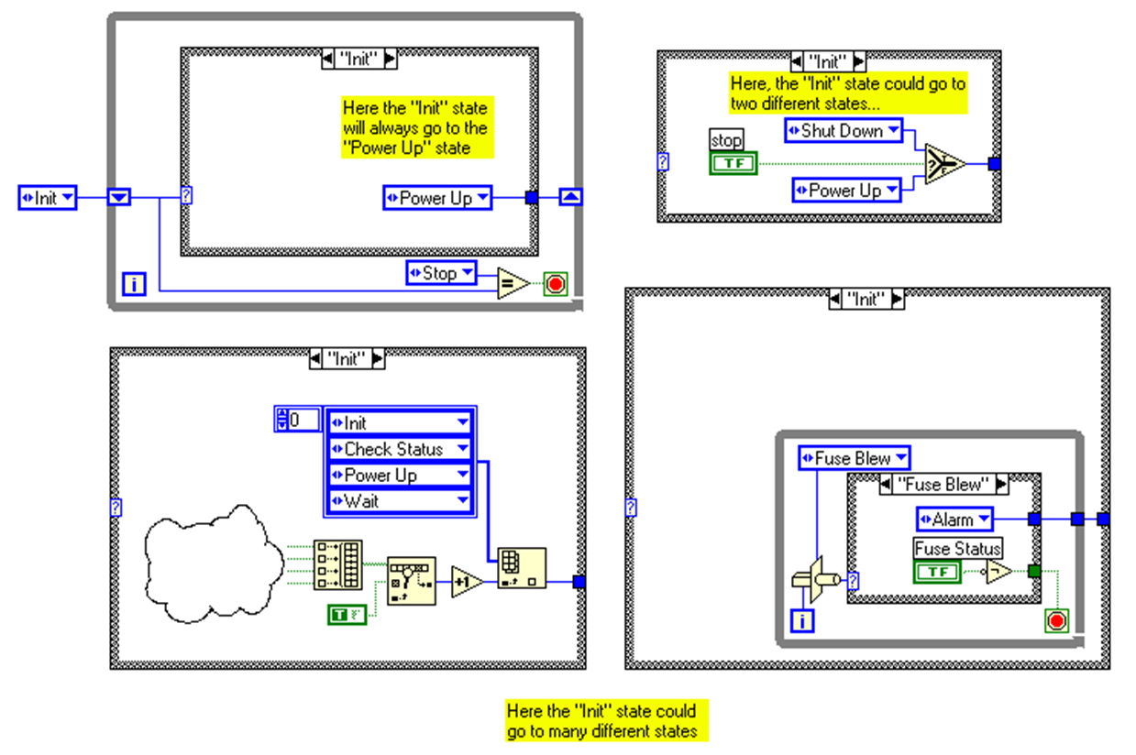
Transition Code Options
Step Execution
Step Execution
Step Execution
Notes:
Each of these case structures shows a different standard type of “transition code” – i.e. code that chooses the next state for the state machine.
The top left code clearly shows that the “Init” state has only one transition, and hence goes directly to the “Power Up” state without making any decision at all. The top right code switches between two possible transitions – the “Init” state will go to the “Shut Down” state if the “Stop” button has been pressed, otherwise it goes to the “Power Up” state.
The code at the bottom left is a little more complicated, but still a common LabVIEW construct. The code for this state returns an array of boolean values, one for each transition we could take. Along with that array of boolean values is another array of enum constants specifying the new states where each possible transition could go. The index of the first “True” boolean in the array corresponds to the index of the new state in the array of enums… (Well, almost, but you can figure out the details yourself – just remember that the “Search Array” function will return –1 if the value is not found).
The code at the bottom right is functionally equivalent to the code to its left. It consists of a case structure embedded in a while loop. The case structure contains one diagram for each transition arrow that leaves the current state. Each of these diagrams has two outputs – a boolean value which specifies whether or not the transition should be taken, and an enumerated constant which specifies the state to which the transition goes. By using the loop index as input to the case structure, this code effectively runs through each transition diagram one by one, until it finds a diagram with a “TRUE” boolean output, and then outputs the new state to which that transition goes. (Note that it is important to make sure the last transition always outputs a TRUE value). Though this code may appear slightly more complicated than the code to the left, it does offer the ability to add names to transitions by “casting” the output of the loop index to an enumerated type. This allows you to add “automatic documentation” to your transition code…

Slide 15
DEMO
State Machine
Notes:
Run the example entitled “1-Coke Machine State Machine.vi”
Use highlight execution to show how it moves between states in the same manner we illustrated earlier.
In order to transition to the next design pattern, observe how because the program is designed to poll for user input that when it’s busy executing code, that the program can miss input (eg.: rapid clicking on the dime will cause the program to miss the ‘depositing’ of several of the dimes)
This implementation uses a traditional state-machine implementation. The idle case
polls for events, which in this case is user input.
If you select and de-selects an input such as a coin or button quickly enough, the state
machine can potentially miss the input. In order to detect the event, the input's value must be polled before you de-select it.
This is a processor intensive and inefficient way to detect user input.
To observe this problem, rapidly click the dime and notice that it does not detect all
clicks.
This example demonstrates the state machine design pattern, but it illustrates one of the
problems we'll address with a more sophisticated implementation later in this presentation.

Slide 16
Recommendations
Use Cases
User interfaces
Data determines next routine
Considerations
Creating an effective state machine requires the designer to make a table of possible states
Use the LabVIEW Statechart Module to abstract this process for more sophisticated applications
Notes:
State machines are common in applications that are basing decision making off of input from a user. Since your application can’t predict the next input from the user, a state machine can be implemented to go to certain states and thereby execute specific code based upon the input from a user while in a certain state.

Slide 17
Event-Driven User Interface
National Instruments Customer Education
LabVIEW
Intermediate I
I am polling for user actions, which is slowing my application down, and sometimes I do not detect them!
Notes:
The next design pattern is commonly used to interact with user input via the front panel. The concept of event driven programming is very important when developing large applications that have to be responsive to user input. Before we get into that, lets look at the alternatives to give us some background

Slide 18
Background
Procedural-driven programming
Performs a set of instructions in sequence
Requires polling to capture events
Cannot determine order of multiple events
Event-driven programming
Determines execution at run time
Waits for events to occur without consuming CPU
Remembers order of multiple events
Notes:
Without the ability to respond to events that occur immediately, programmers are forced to use procedural-driven programming to regularly check for input or check the value of a control. This typically entails encapsulating code within a constant loop that monitors for a change in value and then executes code accordingly. Ideally, the loop would execute fast enough that it doesn’t miss any input. However, there are several significant draw-backs to this methodology:
A constantly running loop consumes CPU time and takes away resources from other things you might want your application to be doing
If an event is detected and code is still being executed while a new event occur, the new value may not be polled and therefore it would never be detected by the program
Multiple changes in value could occur while one particular case is executing. When the loop iterates and polls the values it will not know which one was pressed first.
Example of when this might be a problem:
Imagine a User Interface that has buttons for acquire, log to file and quit
The user presses the acquire button, and while the data is being read clicks ‘log to file’ and then ‘quit’
If these values are detected by the polling at the same time it has no way of knowing which one occurred first and it essentially has to guess, which, as you can image, can easily lead to unexpected behavior

Slide 19
How It Works
Event structure nested within loop
Blocking function until event registered or time-out
Events that can be registered:
  Notify events are only for interactions with the front panel
  Dynamic events implement programmatic registration
  Filter events help you to screen events before they are processed
Notes:
The standard event loop consists of an event structure contained in a while loop. The event structure is configured to have one frame for each category of event you’d like to detect. Each frame contains “handling” code that executes immediately after an event occurs.
Note that it’s important to make sure that the loop termination condition is computed after the handling code completes – one effective method is to compute the condition within the event structure. Alternatively, you could use a sequence structure to ensure that the event structure fires first, or simply add a timeout event to the structure.

Slide 20
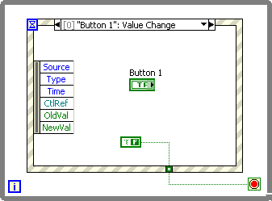
How It Works
Operating system broadcasts system events (mouse click, keyboard) to applications
Event structure captures registered events and executes appropriate case
Event structure returns information about event to case
Event structure enqueues events that occur while it is busy
Notes:
Events are broadcast by OS and responded to by applications
Event structure will enqueue events that occur while executing. Hence you know the order in which events occur.
The UI event loop is a powerful and efficient method for handling user interaction with a LabVIEW program. It’s useful for detecting when a user changes a control’s value, moves or clicks the mouse, or presses a key. Because the event loop wakes up precisely when an event happens and sleeps in between, you don’t have to read control values over and over again (i.e. “polling”) in order to detect when a user presses a button. This will allow you to use the processor much less without risking loss of interactivity…

Slide 21
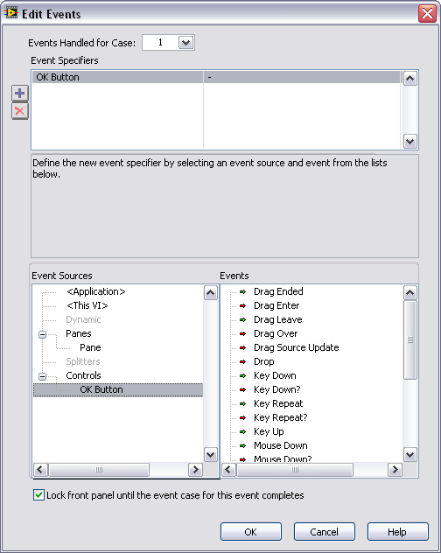
How It Works: Static Binding
Browse controls
Browse events per control
Green arrow: notify
Red arrow: filter
Notes:
Browse Controls – View all the controls you currently have placed
Browse Events per Control – View all the usable events for that control
Notify tells you that an event has already occurred and been processed by LabVIEW (eg. The user just clicked the blue button and LabVIEW has reacted)
Filter tells you that an event has occurred and lets you choose the action that should happen (eg. The user clicked the blue button, what should LabVIEW do?)

Slide 22
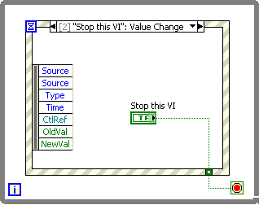
DEMO
Event-Driven User Interface
Notes:
Demo 1
This VI demonstrates a very simple event-driven user interface
Acquire, Analyze and Present are statically registered with the event structure on the block diagram. Clicking any of these buttons will toggle the light next to it.
Each click executes a case with a wait VI. This delays the completion of the event structure case, during which other registered events are enqueued automatically. When the Event structure is waiting, the red light will indicate that it is "Busy"
During the delay, click the other buttons in an arbitrary order. Note that the lights toggle in the same order because the event structure captures all of these clicks
Run this VI in highlight execution to watch how the event structure executes
Demo 2
This implementation of the coke machine uses an event structure for the idle case.
This is very similar to the previous example that uses a state machine, except now we
are guaranteed not to miss any user input due to the fact that the event structure is always enqueueing events
Demonstrate this by rapidly clicking the dime as before and notice that it slowly increments through the values.
However, note that there is a delay between the user input and the program's detection of the user's selection.
This is because the program is 'busy‘ processing data (suppose it's checking to make sure the dime isn't fake) and so we see a delay before it return to the wait state to retrieve the newest user input.
In a later example we'll look at how we can delegate this processing to another state and improve the reaction time to the user input.

Slide 23
Recommendations
Use Cases
UI: Conserve CPU usage
UI: Ensure you never miss an event
Drive slave processes
Considerations
Event structures eliminate determinism
Avoid placing two event structures in one loop
Remember to read the terminal of a latched Boolean control in its value change event case
Notes:
Event structures log all events, even before the structure is called.
Avoid using an Event structure outside a loop.
Remember to read the terminal of a latched Boolean control in its Value Change event case.
Use a Case structure to handle undo operations for a latched Boolean control.
Use caution when you configure one case to handle multiple notify events.
You cannot configure one case to handle multiple filter events with different event data.
If a While Loop that contains an Event structure terminates based on the value of a latched stop Boolean control, remember to handle the latched stop Boolean control in the Event structure.
Consider using the Wait for Front Panel Activity function if you do not need to monitor specific front panel objects programmatically.
User interface events apply only to direct user interaction.
Avoid using dialog boxes in an event case with the Mouse Down? filter event.
When using dynamic registration, make sure you have a Register For Events function for each Event structure.
Avoid using event structures in sub VIs and the main VI together.
Use caution when selecting between a notify or filter event. An event case configured to handle a notify event cannot affect if or how LabVIEW processes a user interaction. If you want to modify if or how LabVIEW processes a user interaction, use a filter event.
Do not use the Panel Close notify event for important shutdown code unless you have taken steps to ensure that the VI does not abort when the panel closes. For example, be sure the application opens a reference to the VI before a user can close the front panel. Alternatively, you can use the Panel Close? filter event, which occurs before the panel actually closes.

Slide 24
Producer/Consumer
National Instruments Customer Education
LabVIEW
Intermediate I
I have two processes that need to execute at the same time, and I need to make sure one cannot slow the other down.
Notes:
I want to execute code in parallel and at asynchronous rates, but I need to communicate between them!
I have two processes that need to execute at the same time, but I want them to be independent of one another, and I need to make sure one can’t slow the other down

Slide 25
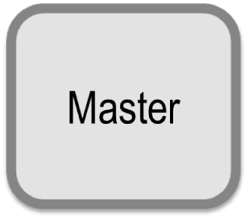
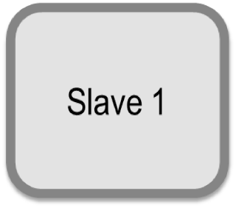
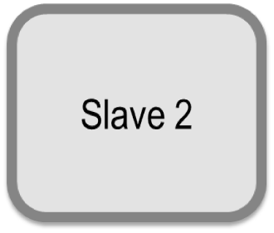
How It Works
Master loop tells one or more slave loops when they can run
Allows for asynchronous execution of loops
Data independence breaks data flow and permits multithreading
Decouples processes
Thread 1
Thread 2
Thread 3
Notes:
This gives you more control on how your application is timed, and gives the user more control over your application.
The standard Master/Slave design pattern approach for this application would be to put the acquisition processes into two separate loops (slave loops), both driven by a master loop that polls the user interface (UI) controls to see if the parameters have been changed. To communicate with the slave loops, the master loop writes to local variables. This will ensure that each acquisition process will not affect the other, and that any delays caused by the user interface (for example, bringing up a dialog) will not delay any iteration of the acquisition processes.
Counterexample: Data-acquisition and data-logging in the same loop. It would be difficult to increase the rate of DAQ without increasing rate of data logging. If they are separate of each other then this is easier to do

Slide 26
Breaking Down the Design Pattern
Data-independent loops = multithreading
Master/slave relationship
Communication and synchronization between loops
Notes:
The standard “design pattern” approach would be to put the acquisition processes in two separate loops, both of them driven by a master loop receives input from the UI controls. This will ensure that each acquisition process will not affect the other, and that any delays caused by the user interface (for example, bringing up a dialog), will not delay any iteration of the acquisition processes. The power of using this pattern is that it separates the data flow of your diagram into independent processes. However, in order for these to communicate, you will have to use some form of globally available, shared data. (e.g. locals, globals, occurrences, notifiers, and/or queues). This does break LabVIEW’s dataflow paradigm, leaves the door open for race conditions, and incurs a little more overhead than passing data by wire. (i.e. acquiring mutexes, etc.)
The producer / consumer pattern is really just a subclass of the master / slave pattern where the main communication between the loops is via queue. Using queues rather than globals to pass data provides a buffering effect – if the data writer occasionally produces data faster than the reader can process it, data will not be lost. This can be especially useful for handling UI events that take a long time to complete (ex. Printing in response to a user)

Slide 27
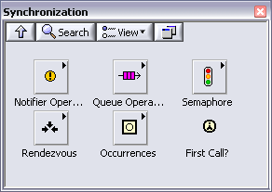
Loop Communication
Variables
Occurrences
Notifier
Queues
Semaphores
Rendezvous
Notes:
Now that we’ve discussed the concept of having multiple loops for separate processes, lets talk about how we can bridge those loops in order to communicate without creating any data-dependency. There are a number of different mechanisms we can use depending upon the communication required. For synchronization and timing an occurrence or rendezvous are helpful.
We’re going to focus on the use of queues
Notifier Operations Functions Use the Notifier Operations functions to suspend the execution of a block diagram until you receive data from another section of the block diagram or from another VI running in the same application instance.
Occurrences Functions Use the Occurrences functions to control separate, synchronous activities.
Queue Operations Functions Use the Queue Operations functions to create a queue for communicating data between sections of a block diagram or from another VI.
Rendezvous VIs Use the Rendezvous VIs to synchronize two or more separate, parallel tasks at specific points of execution. Each task that reaches the rendezvous waits until the specified number of tasks are waiting, at which point all tasks proceed with execution.
Semaphore VIs Use the Semaphore VIs to limit the number of tasks that can simultaneously operate on a shared (protected) resource. A protected resource or critical section of code might include writing to global variables or communicating with external instruments.

Slide 28
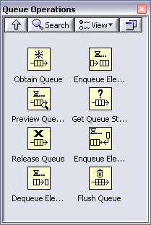


Queues
Adding Elements to the Queue
Select the data type the queue will hold
Reference to existing queue in memory
Dequeueing Elements
Dequeue will wait for data or time-out (defaults to -1)
Notes:
Main elements of a queue:
Obtain Queue – Create and name the queue, define the data type
Enqueue Element – Add data of that type to the queue
Dequeue Element – Remove data from the queue as it becomes available
Release Queue – Destroys the queue when called, eliminating any remaining data.

Slide 29
DEMO
Queues
Notes:
1-Simple queue example is intended to offer a very simple demonstration of how queues work and how it preserves the order in which events are enqueued

Slide 30
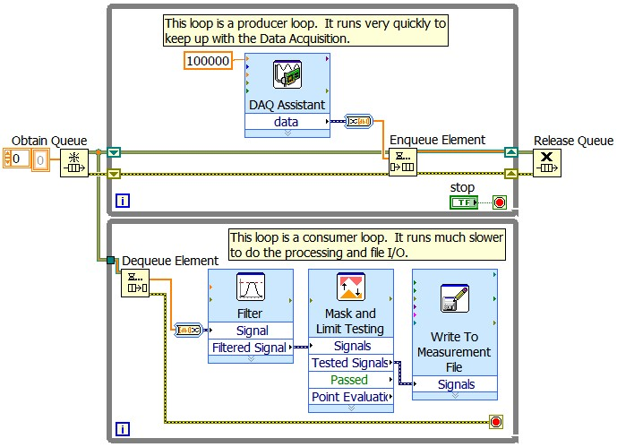
Producer/Consumer
Notes:
One loop produces data (via computation, DAQ, etc.) and puts the data in the queue.
The other loop waits until there is data in the queue. Then it pulls the first element out of the queue and processes it.
These loops both run at different speeds and in different threads of the CPU. This allows us to do rapid data acquisition along with slow signal processing.

Slide 31
DEMO
Producer/Consumer
Notes:
Demo 1
This example simulates communication with a printer to demonstrates the use of producer/consumer loops to delegate responsibility of execution to other part of the application.
Anyone who has used a computer to print a document knows that they can click the print button a lot faster than most printers can actually print the final result.
A separate loop is responsible for setting up the print job and actually printing documents. This ensure that the application can respond immediately to user input and can detect requests for additional print jobs
Demo 2
This is our final example using the coke machine. We’ve resolved the problem we had earlier with the UI responsiveness by delegating the responsibility of processing data to another loop.

Slide 32
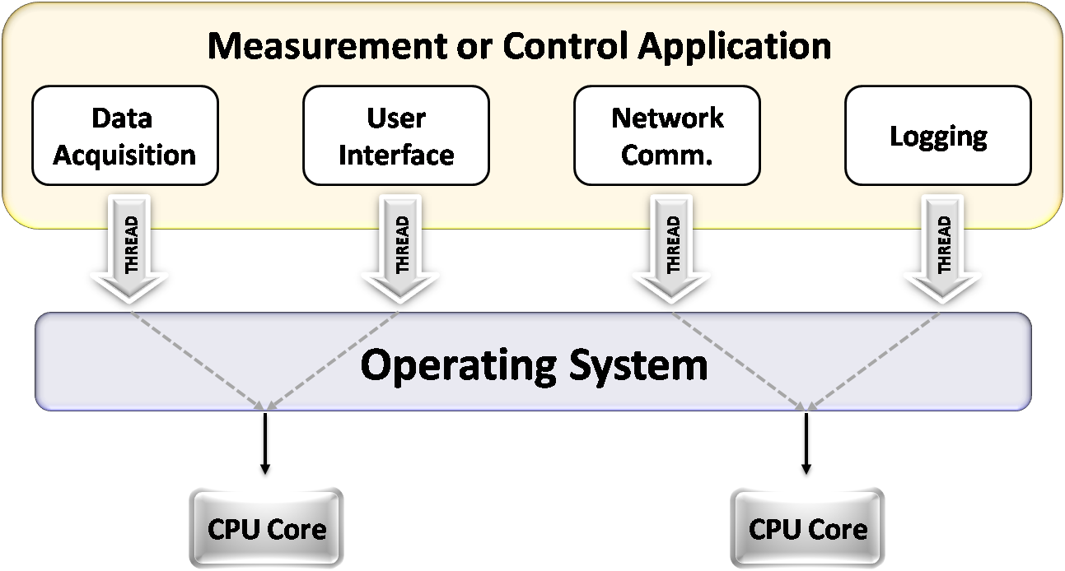
Creating Multithreaded Applications
Data-independent loops automatically spawn separate threads in LabVIEW
Notes:
This is where the notion of multithreading becomes important. Multithreading is just the notion of dividing up your application itself into multiple, independent processes, or more specifically – threads – that you can hand off to the OS so it can divide the work of that application across the multiple cores that are available.
Now, programmers must learn how to break up their applications into multiple threads in order to take advantage of the performance gains available through multicore processors. As you can imagine, this represents a completely new challenge for many developers who are today used to writing their applications in a standard, single-threaded approach.

Slide 33
Recommendations
Use cases
Handling multiple processes simultaneously
Asynchronous operation of loops
Considerations
Multiple producers → one consumer
One queue per consumer
If order of execution of parallel loop is critical, use occurrences
Notes:
Use Cases
Data Acquisition and complex analysis/storage
User interfaces
Instrument control and interaction
Considerations
Multiple producers can pass data to a consumer at slower rates, leading to race conditions (e.g. Producer 1 updates, Producer 2 doesn’t and thus the consumer uses new data from Producer 1 and old data from Producer 2)
Do not have multiple consumers pulling from the same queue. Use separate queues for each consumer.
Use occurrences to trigger a loop to continue after another loop has reached a certain point.

Slide 34
Object-Oriented Programming – Factory
National Instruments Customer Education
LabVIEW OOP System Design
I need my application to be scalable and modular without sacrificing memory efficiency.
Notes:
Now we are going to consider one of the more advanced design patterns: the Factory deign pattern using Object Oriented Programming. Because this design pattern utilizes OOP, it requires a more extensive knowledge of LabVIEW programming.

Slide 35
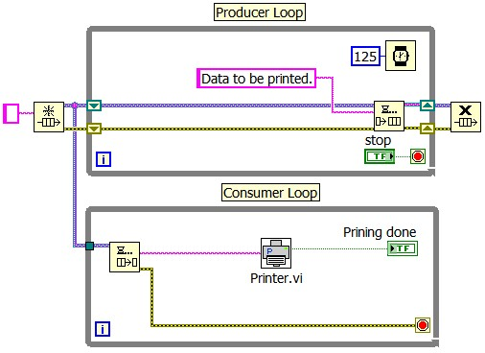
Object-Oriented Programming
What if we need multiple printers of different types?
Notes:
Consider the Producer/Consumer printer example we discussed earlier. This diagram is a simplified version of what we did before, but the architecture is the same. What happens if we need to use the application on a system with a different type of printer? Nothing in our VI would need to change, except how we handle the printer. But to handle multiple types of printers, we would need a case structure and a separate sub VI for each type of printer. The more printer options we add, the more convoluted the code becomes and the more we have to load into memory. This is a lot of excess overhead for a relatively minor function in our code.
Object Oriented Programming gives us a way to dynamically select what portion of code to load into memory and use at runtime.

Slide 36
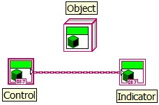
Object Orientation – Classes
A glorified cluster
A user-defined data type
A type of project library
Notes:
In object-oriented programming, classes represent general traits that items share. You can visualize a class, generically, as something like a printer. Printers share common traits and the class defines those traits. An object is a specific occurrence of a class. An object of an printer class can be the specific Dell printer you use at home, or the HP laser printer at work. The class definition determines how your printer, the object, behaves.
Many printers exist in the world. You can generically classify all types of laser devices, inkjet devices, or copier devices as printers. Information about whether the printer uses color or grayscale, what paper sizes, or what resolution are all properties of the printer. Printers can print, collate, and occasionally fax information. Printing and collating are behaviors, or methods, of the printer. The data and methods associated with the automobile define the class Automobile. You create classes to define the data and methods of the object.
LabVIEW classes are user-defined data types and the functions (VIs) which operate on that data. A LabVIEW class can be thought of as a glorified cluster, with defined VIs for accessing that cluster. You view and interact with a LabVIEW class through the LabVIEW Project Explorer. For example, this project contains a LabVIEW class called Automobile, which has Start Automobile and Stop Automobile methods.

Slide 37
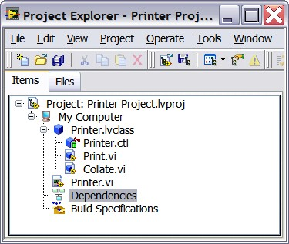
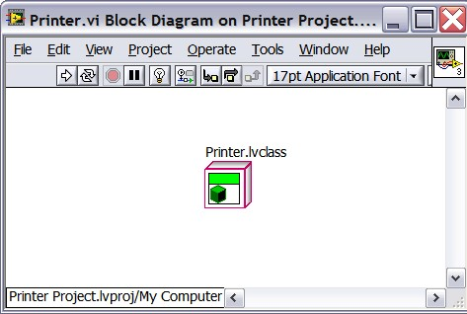
Object Orientation – Objects
An object is a specific instance of a class
Object data and methods are defined by the class
Notes:
An object is a specific instance of a class. The printer that you use at work is a specific implementation of class Printer, or an object of class Printer.
The block diagram shown on this slide of Main VI displays an object of class Automobile. Objects have data and methods defined by the class. LabVIEW stores class data in a control and you create member VIs that are the methods of the LabVIEW class.
To create a new object of a class in LabVIEW, simply drag the class to a front panel or block diagram.

Slide 38
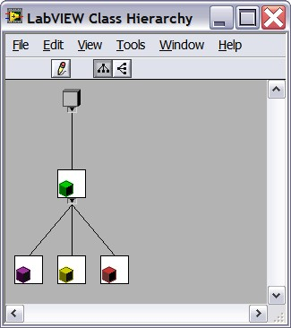
Object Orientation – Inheritance
Each child class inherits methods and properties from its parent
Each child class can also have its own unique methods
Printer
Laser Printer
Copy Machine
Inkjet Printer
Notes:
One of the key premises of Object Oriented Programming is inheritance. Inheritance allows you to use an existing class (parent class) as the starting point for a new class (child class). For example, both Laser Printer Class and Copy Machine Class inherit from Printer Class. Both a laser printer and a copy machine are examples of types of printers. They inherit, or extend, parent methods such as Print Color and Collate.

Slide 39
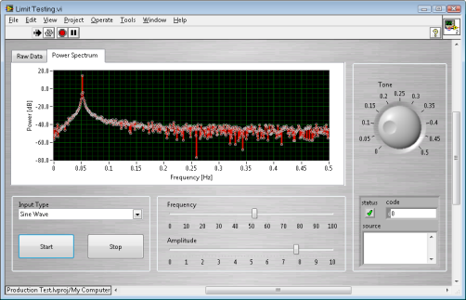
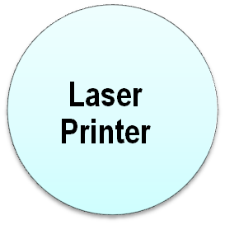
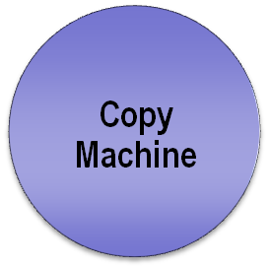
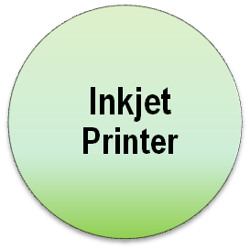
Object Orientation – Dynamic Dispatching
Calling VI determines which version of a subVI to use at run time. This prevents unneeded subVIs from being loaded into memory.
Notes:
Dynamic dispatch methods are similar to polymorphic VIs. Where polymorphic VIs determine which VI to call depending on the data type you wire to it at edit-time, dynamic dispatch methods wait until run time to determine which member VI in the class hierarchy to call depending on the data that arrives at the input terminal.
This allows us to only place one instance of the VI in memory, instead of loading code for each iteration of the VI and then only using one while the program is running. This leads to more efficient code and better upgradability.

Slide 40
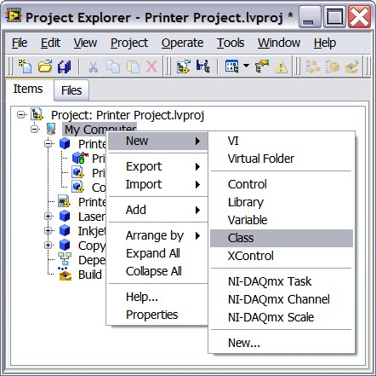
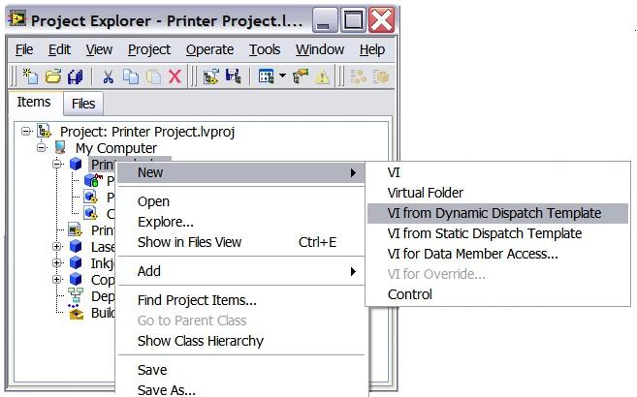
Object Orientation – Creating Classes
Create a class from within a project
Add VIs to the class to control methods and properties
Notes:
In order to create a class, right click “My Computer” in your project and select New » Class. You can then add VIs of various kinds to the class. Unlike normal subVIs, all classes and their subVIs must exist in a project to be used in your LabVIEW code. This is one of the limitations of using an OOP based design pattern like the Factory.

Slide 41





How It Works – Factory
Factory design pattern
One subVI handles the interaction and selection of the modular object
Dynamically selects which subVI to load into memory
Modularity only requires adding the new class to the project and modifying the subVI that chooses which class to call
Notes:
The Factory design pattern uses some input (e.g. an enumerated constant, string, numeric, boolean, etc.) to dynamically load a child class into memory. In the image above, the “Select Printer” VI serves as a “Factory” that will produce whichever child class is selected.
The basic idea is this: Use some bit of data to identify the path to the class you are interested in loading. Load the class into memory and get an instance of that class.
Once you have used the factory to get a particular class of data, you are free to use it as you would any other class. Commonly, you would wire the chosen class instance to an Init method of the class which would take your data as an input. The advantage of this system is that the child class is only loaded into memory if someone actually wants to instantiate that child. If you have a great many possible types of classes, this can save on memory and load time for your application. The name of this pattern comes from the fact that a single VI serves as a factory to produce all the myriad child types.
Once loaded into memory, a class will stay in memory as long as its parent class is running or there are any objects of that class type still in memory. Since objects can lurk all over the place – as the operate value of controls and indicators, as the last value in an uninitialized shift register, etc – it is basically impossible to dynamically unload a class once it is loaded. You should not attempt any architecture that is predicated on being able to unload and reload a class.

Slide 42
DEMO
Object-Oriented Programming – Generic Factory Pattern
Notes:
Demo 1
This example loads only the Generic Plugin VI to memory. As different controls are selected, the new sub VIs are loaded into memory. Expanding this application merely involves writing a new sub VI and updating the Generic Load by Enum VI.

Slide 43
Recommendations
Use cases
Applications needing high-level modularity or scalability
Memory conservation when loading subVIs
Considerations
More complex; requires strict architecture
Not needed for limited applications
Notes:
Use Cases
Applications needing a high level of modularity or scalability – Use when your application will be deployed on systems in many varying configurations or with a wide variety of hardware.
Memory conservation when loading subVIs – If your subVIs are very complicated, it is better to only load the subVI you need, instead of the all of the possible subVIs to conserve system memory.
Considerations
More complex, requires strict architecture – All your subVIs and classes must be present in your project and you must follow the parameters of object oriented programming in order to utilize the Factory design pattern.
Not needed for limited applications – If you only need a three or four separate possibilities, it will likely be more efficient from a complexity standpoint to just use a state machine, as OOP requires a fundamental shift in programming practices.

Slide 44
Using Design Patterns
Let’s put what we have learned to use.
Notes:
Now lets put what we’ve learned into action.

Slide 45
Using Design Patterns
Problem: Create a responsive user interface
We need an application with a responsive user interface that detects user inputs and reacts accordingly. This user interface should not use excessive CPU resources. The actions we need to take are not dependant on each other.
Solution: Event-Based Design Pattern
We should use an event-based design pattern because we need to limit the CPU usage while waiting for events. We should not encounter any race conditions because our actions are independent of each other.
Notes:
Now lets consider four different applications.
Create a user interface – We need to write a user interface that will monitor for commands from the user without slowing down other processes running on the system. These inputs could range from button clicks to keyboard commands.
Solution: Event Based Design Pattern
We should use an event based design pattern because we need to limit the CPU usage while waiting for events. We should not encounter any race conditions because our actions are independent of each other.
Note: If some of our actions are incompatible, we need strong guards against executing an incorrect action, lest we damage any hardware or some other equally unfortunate event.
Open the demo example and the Task Manager, and view the CPU usage graph. Switch between using the event structure and not and see how the core maxes out CPU usage when not using the event structure.

Slide 46
Using Design Patterns
Problem: Test and calibration system
We need to test several devices on a production line. Based on the results of the test, we may need to calibrate the system using one of two calibration routines, then retest the system.
Solution: State Machine
Because we do not know which of the calibration routines we need to use, we should use a state machine to dynamically select which of the two states we should enter.
Note: We should NOT use the object-oriented programming factory design pattern for this because we only have two calibration routines. Using object-oriented programming would be needlessly complex.
Notes:
Problem: Test and calibration system
We need to test several devices on a production line. Based on the results of the test, we have three possible results: 1. pass the device, 2. calibrate it using Procedure 1, calibrate it using Procedure 2. Then, if we had to calibrate the device, we need to retest it and choose whether to pass, calibrate, or fail the device again.
Solution: State Machine
Because we don’t know which of the calibration routines we need to use, we should use a state machine to dynamically select which of the two states we should enter. The allows us to program each state once, and return to the test code at the end of the calibration.
Note: We should NOT use the OOP Factory design pattern for this, because we only have two calibration routines, using OOP would be needlessly complex.
Launch the demo and choose which tests should be failed. Observe how the VI moves through the states.

Slide 47
Using Design Patterns
Problem: Data acquisition and data logging
We need to acquire data from two external instruments that sample at different rates, filter the data, add the time of the test and the operator who performed the test to the data, and then write it all to a file.
Solution: Producer/consumer
We should use the producer/consumer architecture because we have multiple tasks that run at different speeds and cannot afford to be slowed down. Each of the external readings will be in separate producer loops and the data processing and logging will be in the consumer loop.
Notes:
Problem: Data acquisition & data logging
We need to acquire data from two external instruments that sample at different rates, filter that data, add the time of the test and the operator who performed the test to the data, then write it all to a file. Each instrument reads at a different rate. Because of the signal processing and file creation, that portion will operate slowly.
Solution: Producer/Consumer
We should use the Producer/Consumer architecture because we have multiple tasks that run at different speeds and that can’t afford to be slowed down. Each of the external readings will be in separate producer loops and the data processing and logging will be in the consumer loop.
Note: We must be sure not to release either queue until the consumer loop is done running, or we will lose data.

Slide 48
Using Design Patterns
Problem: Dynamically render a group of 3D objects
We need to create a series of 3D objects and display them. These objects will be different from each other but will share some similar properties. The number of each type that we will need to create will not be known until the program runs.
Solution: Object-oriented programming
We should use object-oriented programming with a factory that produces the proper number of each type of 3D object. Because we do not know how many will be produced beforehand and they all share some similar properties, dynamically creating these objects from an object-oriented programming factory is the most efficient solution.
Notes:
Problem: Render a group of 3D objects dynamically
We need to create a series of 3D objects and display them on a 3D picture control. These objects will be from four different types, but will share some similar properties, such as position, velocity, size, etc but will also have unique properties such as color and shape. The number of each type of object that we will need to create will be determined by the user when they run the program and won’t be known until the program is run.
Solution: Object Oriented Programming
We should use Object Oriented Programming, with a Factory that produces the proper number of each type of 3D object. Since we don’t know how many will be produced before hand and they all share some similar properties, creating these objects from an OOP factory dynamically is the most efficient solution.

Slide 49
DEMO
Object-Oriented Programming – 3D Object Field
Notes:
Demo - 3D Object Field
Example: Run the example and see the stars and planets generated dynamically on the 3D Picture Control. Stop the VI and change the proportion of the three starfield objects and show how this changes the number of each object that is generated.
Change the properties for size, velocity, and position. These properties are shared by all three instances of the 3D Stars class. The hierarchy is for this demo is shown below:

Slide 50
Resources
Example Finder
New>>Frameworks>>Design Patterns
ni.com/statechart
ni.com/labview/power
Training
  LabVIEW Intermediate I and II
White paper on LabVIEW Queued State Machine Architecture
  Expressionflow.com

Slide 51
How to Develop
Your LabVIEW Skills
Notes:
Widespread exposure to LabVIEW in our schools a great long-term strategy grow the pool of fellow LabVIEW enthusiasts and future colleagues. However, equally important to us is grow the skills of our existing user base to be able to take advantage of the expanding technology in LabVIEW. The single biggest driving factor in the success of LabVIEW over the years has been the success, efficiency, and exuberance of our LabVIEW user community – and we believe it is vital that you are taking advantage of the resources we have to offer to be able to solve more and more applications with LabVIEW.

Slide 52
Fast Track to Skill Development
New User
Experienced User
Advanced User
Courses
LabVIEW Advanced I
Core Courses
LabVIEW Intermediate I
LabVIEW Intermediate II
Begin
Here
LabVIEW Basics I
LabVIEW Basics II
Certified LabVIEW Architect Exam
Certifications
Certified LabVIEW Developer Exam
Certified LabVIEW Associate Developer Exam
If you are unsure take the
- Quick LabVIEW quiz
- Fundamentals exam
ni.com/training
Notes:
Here we show the LabVIEW Skill Development Plan, which is a sequence of LabVIEW courses and certifications to ensure your success with LabVIEW and gain recognition for your technical expertise.
The LabVIEW Skill Development Plan consists of:
Basics and Advanced courses for new and experienced users
Basics courses focus on teaching the LabVIEW environment to get you started quickly, while Intermediate and Advanced courses teach programming techniques and large application design to optimize your use of LabVIEW.
Core courses are recommended training to maximize your productivity gains.
NI courses are organized in a modular series, so you can choose the courses that offer the right level of skills for you to develop your applications.
As you develop your skills, NI offers different levels of LabVIEW certifications for you to recognize and gain credibility for your technical expertise. The Associate Developer, Developer, and Architect levels of product-based certifications identify individuals with basic, advanced, and expert knowledge in using LabVIEW.
With NI training and certification, you can:
Get your application right the first time and save a considerable amount of development time and cost
Choose the training format that best meets your needs - instructor-led classroom, online or onsite along with self-paced formats.
Differentiate skills with professional credentials for career growth
Next slide: Our newest training program is a one-year training membership with access to all scheduled training courses at a low price of $4999.
For detailed course descriptions, a schedule of courses in your area, or to register, please call or visit ni.com/training.

Slide 53
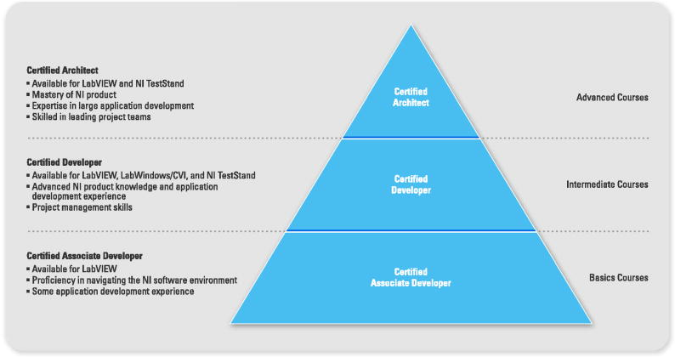
Certification
Notes:
3 levels of certification.
The associate developer level is the foundation of the program and shows a basic proficiency with NI software.
The certified developer is the level most people should aim for. It demonstrates and advanced level of knowledge, that shows you have the technical skills needed to develop robust applications.
Certified Architects have expertise in creating the architecture for large applications and the skills needed to lead a team of developers.

Slide 54
Training Membership: The Flexible Option
Ideal for developing your skills with NI products
12 months to attend any NI regional or online courses and take certification exams
$5,499 USD for a 12-month membership in the USA
$4,799 USD for a 6-month membership in the USA

Slide 55
Next Steps
Visit ni.com/training
Identify your current expertise level and desired level
Register for appropriate courses
  $200 USD discount for attending LabVIEW Developer Education Day!

Slide 56
LabVIEW Learning Paths
LabVIEW Advanced I: Large Application Development
LabVIEW Object-Oriented Programming System Design
Advanced
Intermediate
LabVIEW Intermediate I and II
LabVIEW Real-Time Application Development
CompactRIO Fundamentals and LabVIEW FPGA
LabVIEW Instrument Control
RF Fundamentals and RF Application Development
LabVIEW Machine Vision and Image Processing
LabVIEW DAQ and Signal Conditioning
Specialty
LabVIEW Basics I and II
Foundation

Slide 57
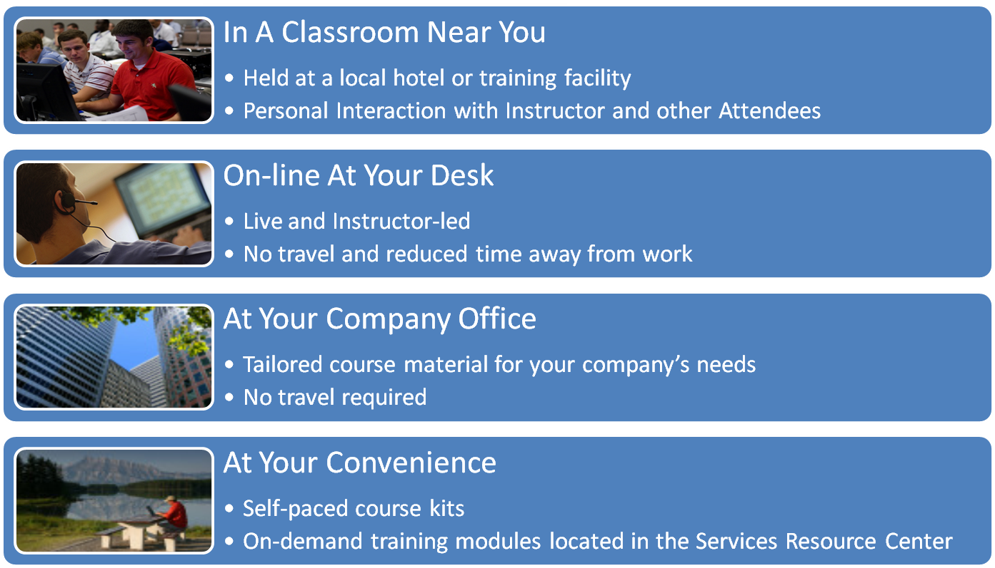
Ways To Learn LabVIEW

Slide 58

Training & Certification Membership Program
Unlimited access to all regional and on-line courses for one year
Unlimited access to all certification exams for one year
Option to retake all courses and exams
ONE PRICE

Slide 59
Questions?

